Slide 1
The learning conversation
Kirsty Maclennan

Slide 2
Thoughts to cover….
Why are we anxious?
How can an early learning conversation help?
How can simulation help?

Slide 3
How do our worries sit with human factor models?

Slide 4
Consider what worries you about working in that area.
Your gut feeling is important…

Slide 5
Now let’s map your concerns to a human factor model
Consider the SHELL model
(Develop awareness of human factors in the work place)
Notes:
- One of a number of techniques used to develop awareness of human factors in the work place

Slide 6
Induction
Kit
Medical devices
Computers
Beds
Risk
Hardware
SOPs
Guidelines
Checklists
Software
Environment
Noise
Sound
Temperature
Space
Liveware
Person
Knowledge
Skill
Anxiety re covid
Personality
Learning
conversation
Liveware
People interacting with people
SHELL MODEL

Slide 7
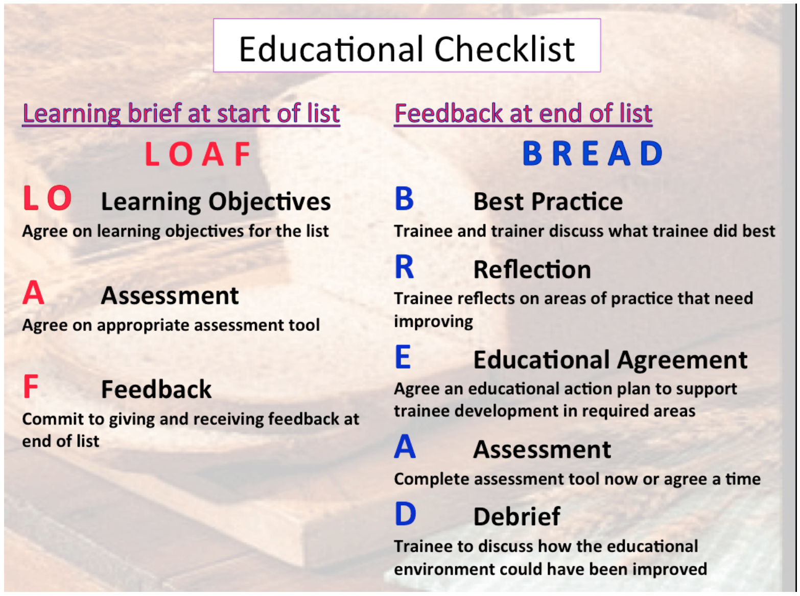

Slide 8
Here’s the wellbeing version
6-point checklist
At the start of a session
Acronym –
You are lovely helpful friendly people

Slide 9
U - Useful tips
R - Rest needed pre leaving
Lovely - Learning objectives
Helpful - Help, how to escalate
Friendly - food, plan breaks
People – PPE, in an emergency

Slide 10
U - Useful tips
R - Rest needed pre leaving
Lovely - Learning objectives
Helpful - Help, how to escalate
Friendly - food, plan breaks
People – PPE, in an emergency

Slide 11
U - Useful tips

Slide 12
R - Rest needed pre leaving

Slide 13
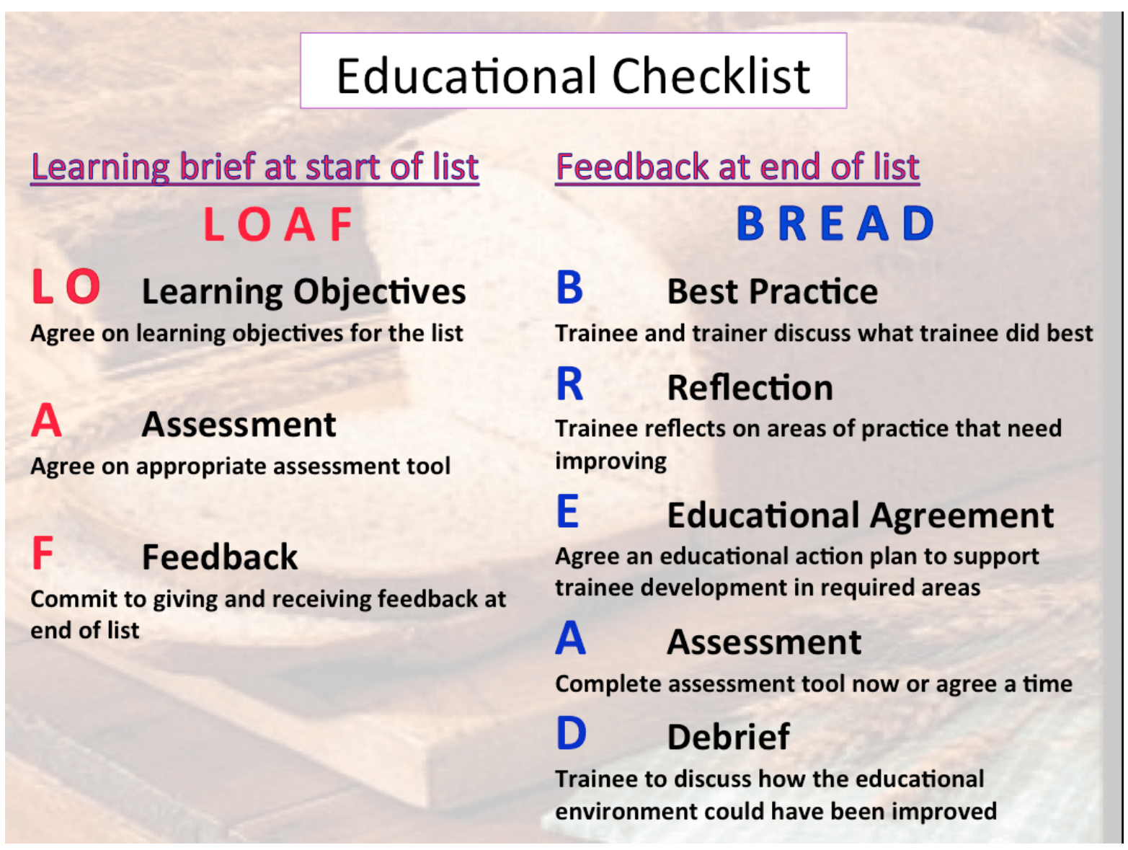
Think SHELL model
Lovely - Learning objectives

Slide 14
Think SHELL model
Lovely - Learning objectives

Slide 15
Helpful - Help, how to escalate

Slide 16
Friendly - food, plan breaks

Slide 17
People – PPE, in an emergency

Slide 18
Put it all together
at the start of your session
U - Useful tips
R - Rest needed pre leaving
Lovely - Learning objectives
Helpful - Help, how to escalate
Friendly - food, plan breaks
People – PPE, in an emergency

Slide 19
How can simulation help
Ask yourself and your team.
What worries you most?
What are you least able to cope with?
Today’s example…

Slide 20
Don’t forget the debrief…..
Talk about it after the event
Share learning at the handover
Make changes if you think it will help others
Simulate it to increase confidence

Slide 21

You are lovely friendly helpful people!
Remember that every day…

